Slide 1
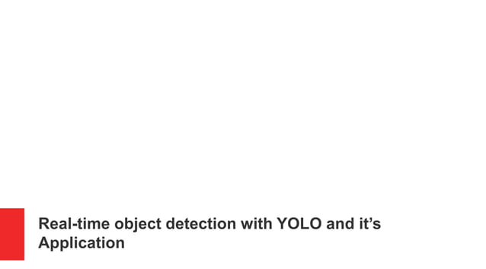

Slide 2
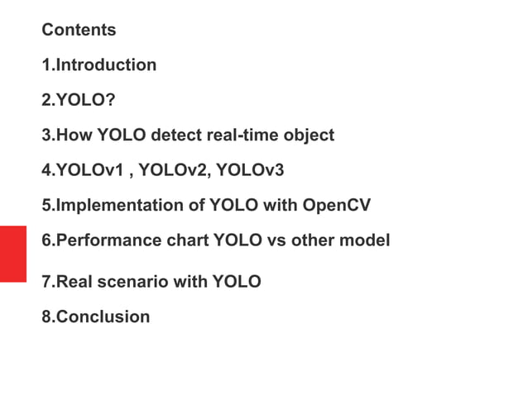

Slide 3
Outline
Haar-feature based object detection algorithm
Custom design space exploration: Feature mapping problem
Experimental results

Slide 4
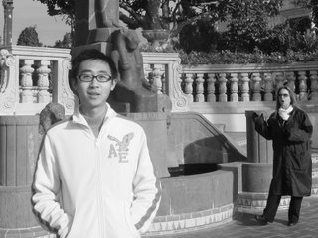

Haar-Feature based object detection algorithm
X axis
320
Original image
0
Scaled images
Y axis
Face found
20x20
sub- window
…
240
Faces detected on different scales
Movement of sub-window
(320 – 20) * (240 – 20) = 66,000 sub-windows

Slide 5

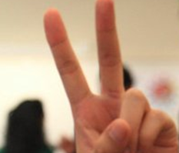
Face detection in sub-window
Original image
Integral Image
Facial Haar features
1 1 1
1 2 3
1 1 1
2 4 6
1 1 1
3 6 9
Pass
Stores Pixel sum of Rect(from top-left corner to this point)
Need 4 corner values
20 x 20 sub-window
p1
p2
P1
P2
R1
p3
p4
P3
P4
Fail
Pixel_Sum(R1) =
P4 - P2 - P3 + P1 = 4
Calculate Haar-feature value:
Pixel_Sum(Rect_W) – Pixel_Sum(Rect_B)
Constant time Pixel_Sum calculation

Slide 6
Cascade decision process
Frontal-face has 2000 features
Divided into multiple stages
S1
2 features
pass
S2
5 features
pass
S3
16 features
pass
S22
212 features
pass
……
Face detected
Fail
Reject
Fail any stage will reject current sub-window

Slide 7

Algorithm FPGA implementation
FPGA
Video out
(objects in rectangles)
Video in
20 x 20 Sub-window
Integral image
Frame grabber
Rectangle
drawer
Image scaler
Buffer controller
Classifier
Haar feature calculation/decision

Slide 8

Integral image and Classifier
Data delivery
a1 a2 a3 a4
b1 b2 b3 b4
c1 c2 c3 c4
Rect sum
Rect sum
Rect sum
0
Integral Image Buffer
(20 x 20 17-bit register file)
mux + multiply by constant
-1
x2
x2
x3
Video out
(objects in rectangles)
+(Feature sum)
Video in
Integral image
Feature threshold
>
Frame grabber
Rectangle
drawer
Left value
Right value
Feature value
Image scaler
Buffer controller
Classifier
Classifier

Slide 9
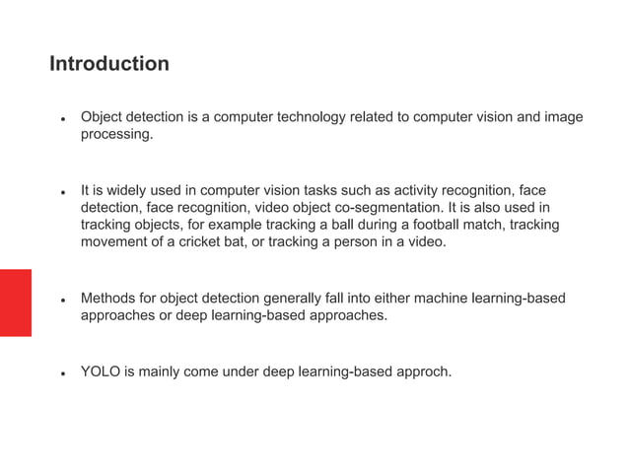

Slide 10
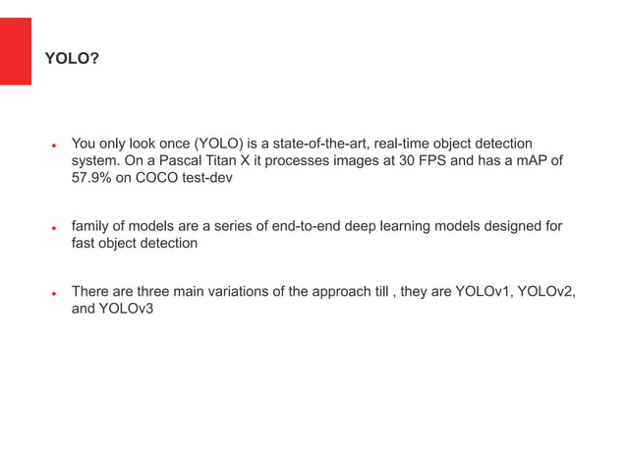

Slide 11
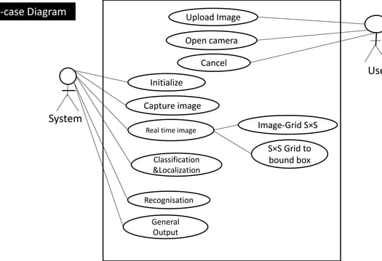

Slide 12
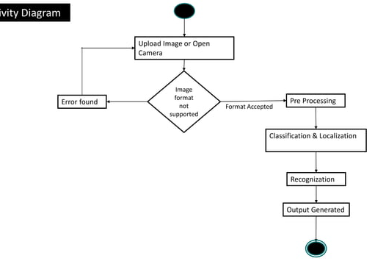

Slide 13
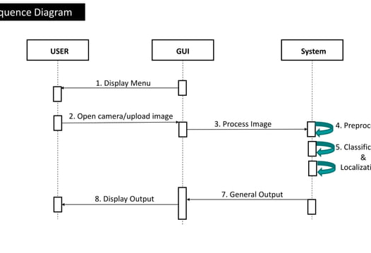

Slide 14
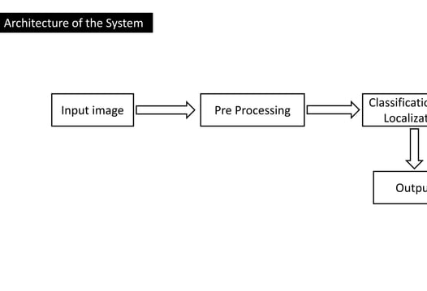

Slide 15
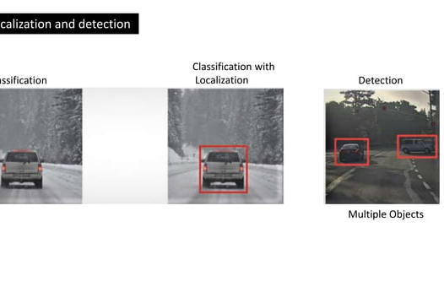

Slide 16
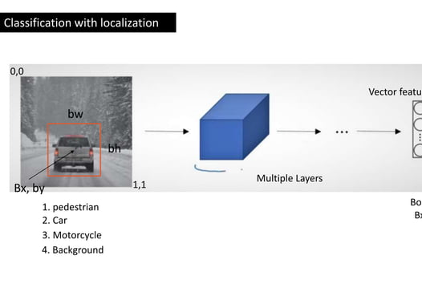

Slide 17
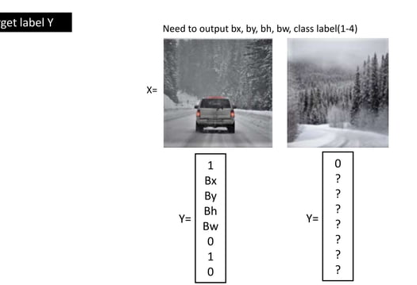

Slide 18
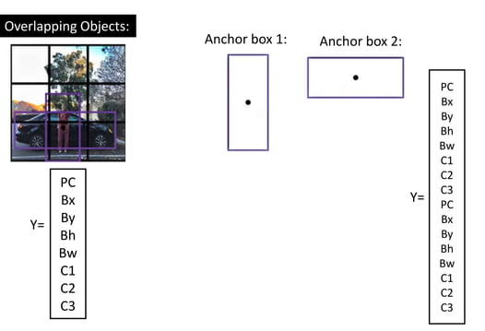

Slide 19
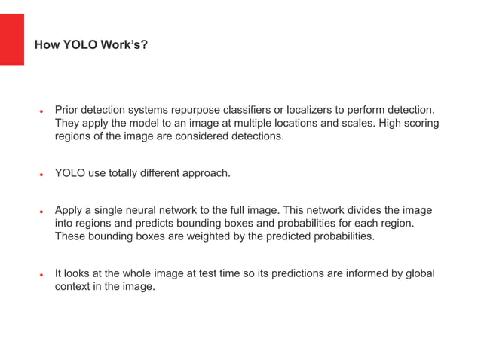

Slide 20
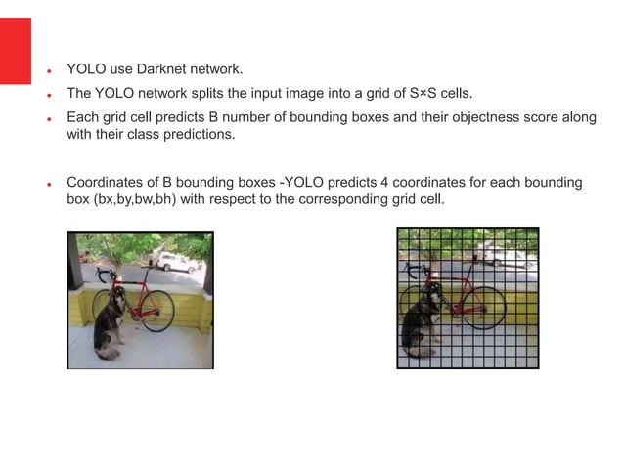

Slide 21
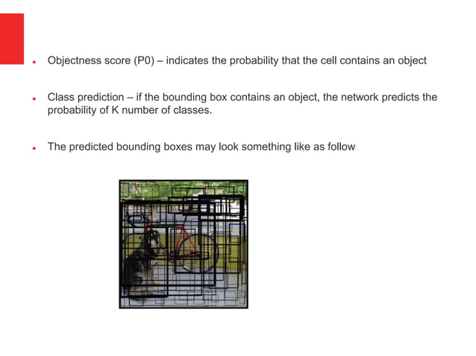

Slide 22
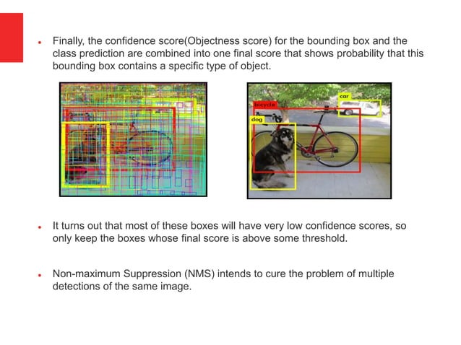

Slide 23
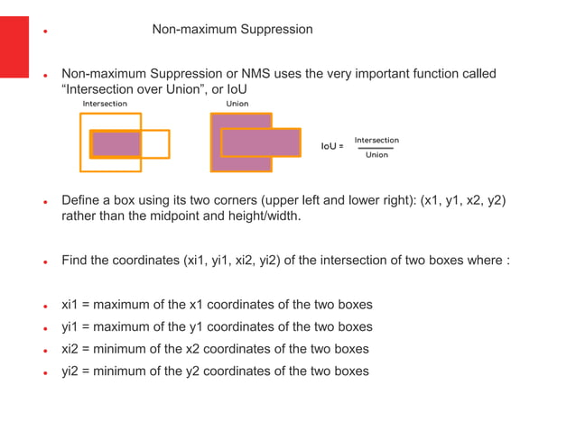

Slide 24
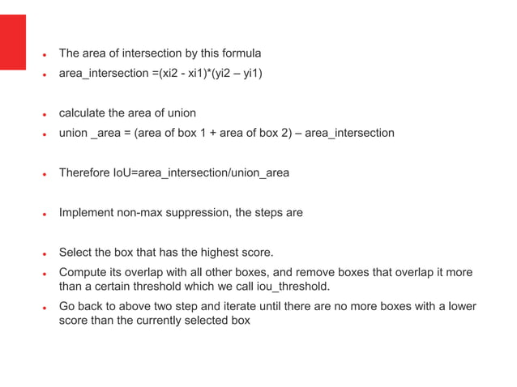

Slide 25
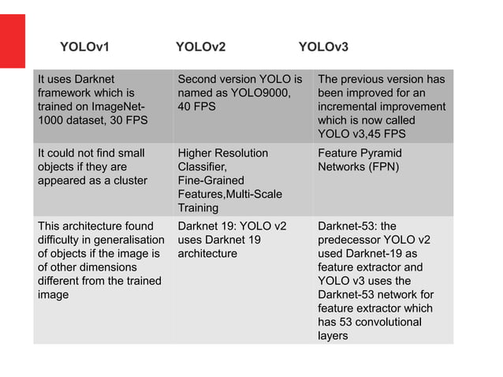

Slide 26
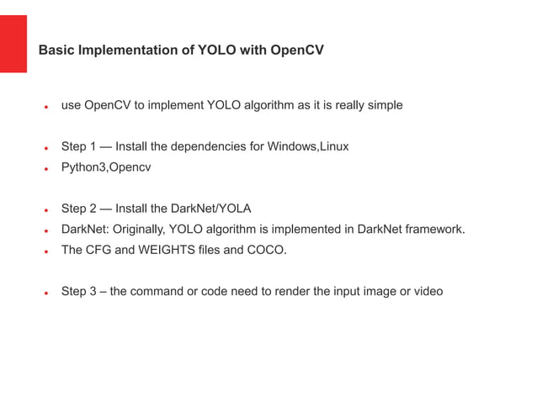

Slide 27
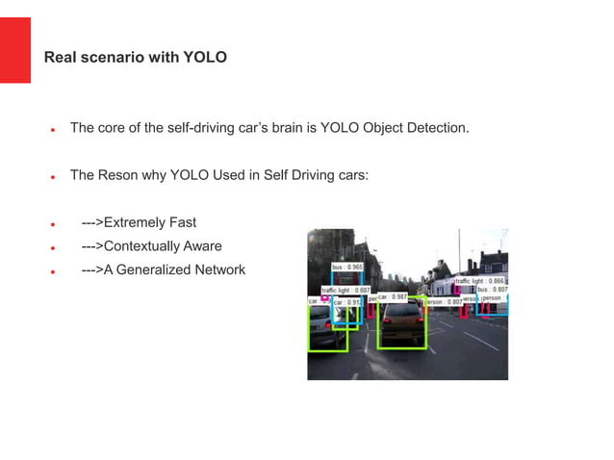

Slide 28
